Slide 2
Cluster:
same hardware
same AZ,
Spread: max: 7(same group)/AZ
Different hardwares
Different racks
Different AZ
Partition:
Different/ same hardwares(AWS decides)
Different racks
Same/different Azs
Instances of same partition should not share other rack.

Slide 4
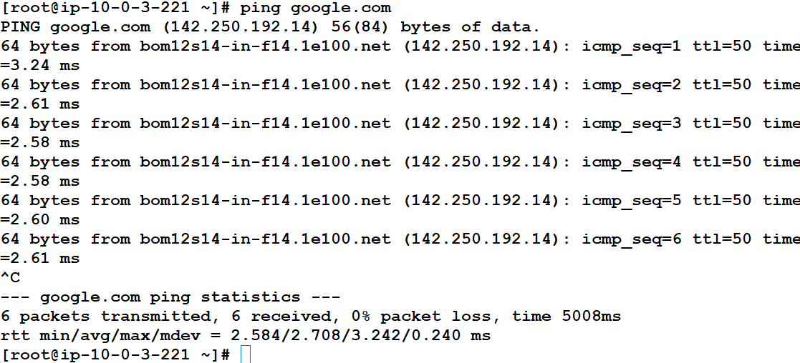
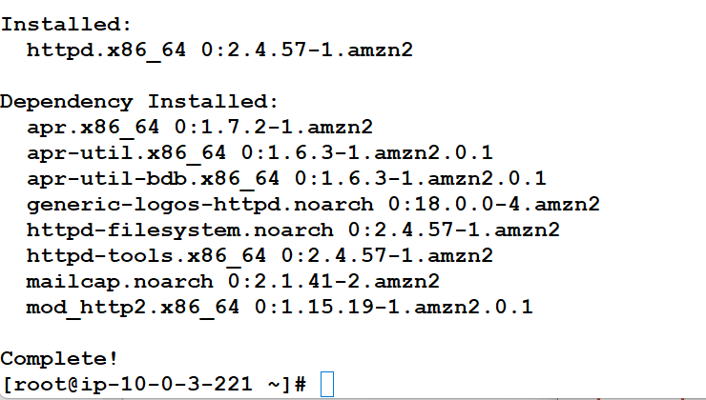

Slide 5
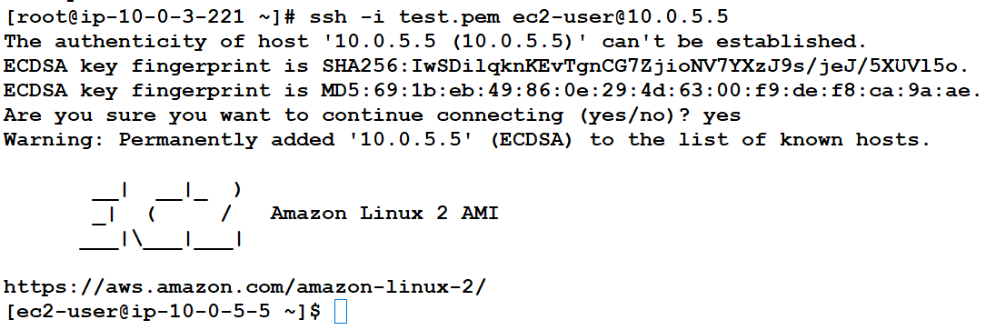
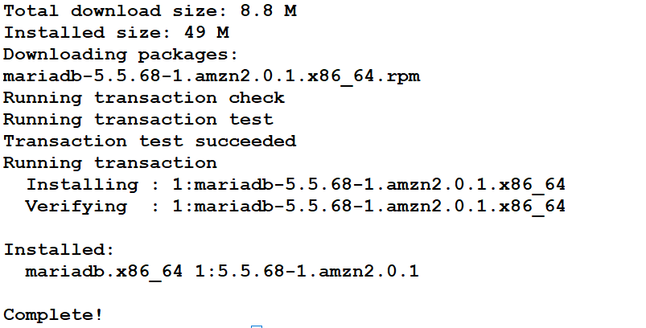
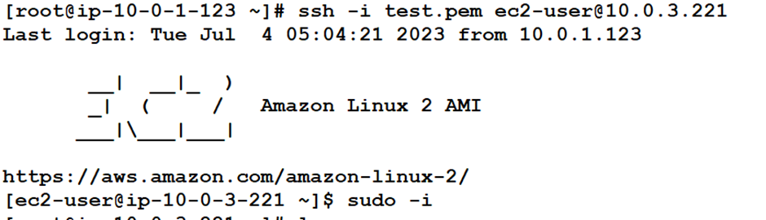

Slide 6
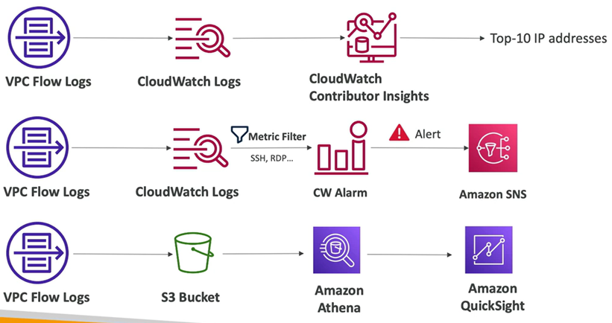
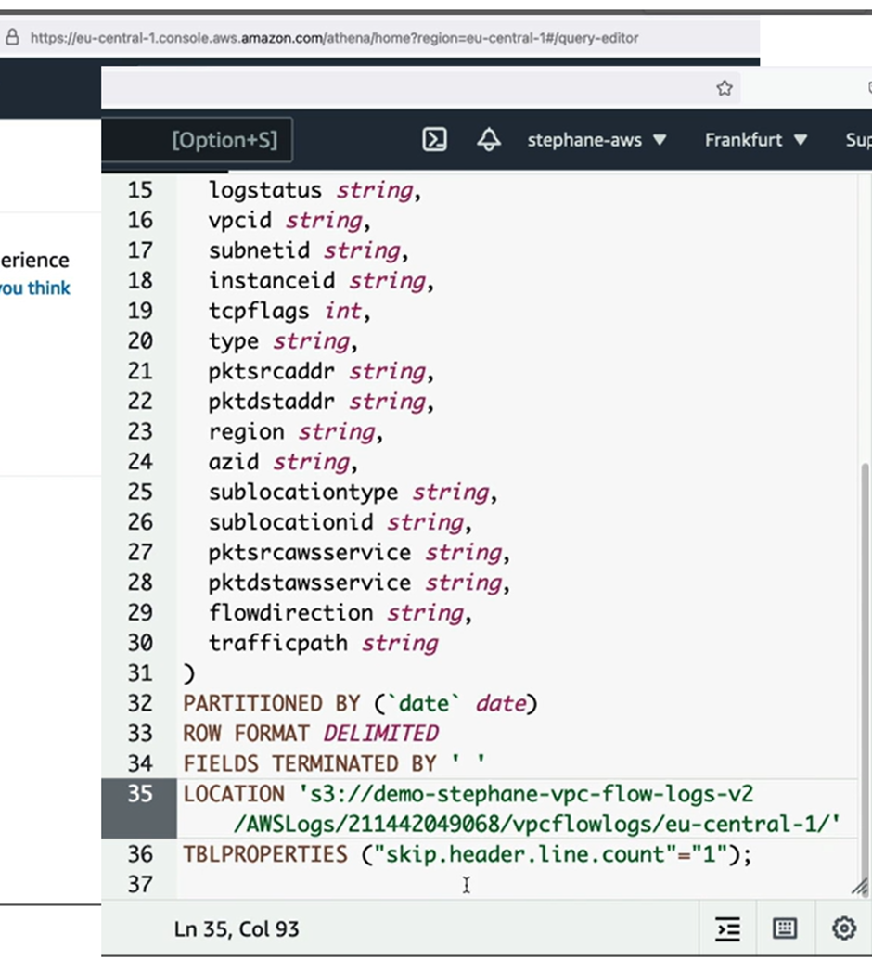
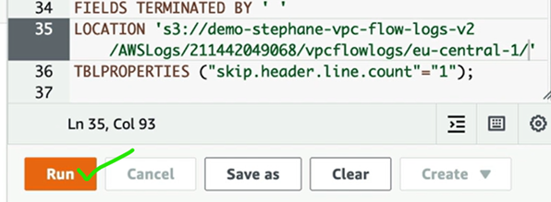

Slide 7
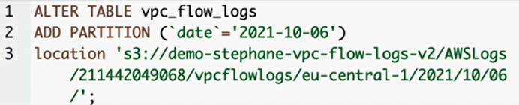
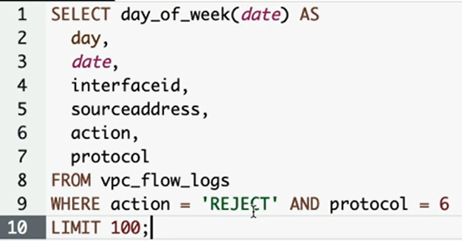
VPC Requirements: VPC, 2 subnets,1 IGW,2 RTs, bastion server, private server, NAT, SGs,
Create flowlogs (name,alltype,time:1 min)
Console: cloud watch log, groups, name, retent:1 day,
Send to amazon s3
Send to cwlogs
Create s3 buckets, copy arn
Paste arn
Log group, select
Create role, custom trust policy,edit principal,cloudwatchlogfull access,create
Aws default format
IAM role,
select
Goto s3 and refresh and check
create
create
Goto s3, create a bucket for query result location
Goto anthena query editor, querylocation (arn),settings, specify, save
Goto loggroup, refresh and check with (eni ids of servers) open and check the details
Goto link:https://docs.aws.amazon.com/athena/latest/ug/vpc-flow-logs.html
Click editor of the anthena
Whole table with data
Link: Copy the first program statement, edit location, paste and run in the anthena editor
Partition
Link: copy 2nd , alter location, run
Link: copy 4th (to find reject traffic), paste,no edit, run
Anthena editor
Below we can see the results of our query

Slide 8
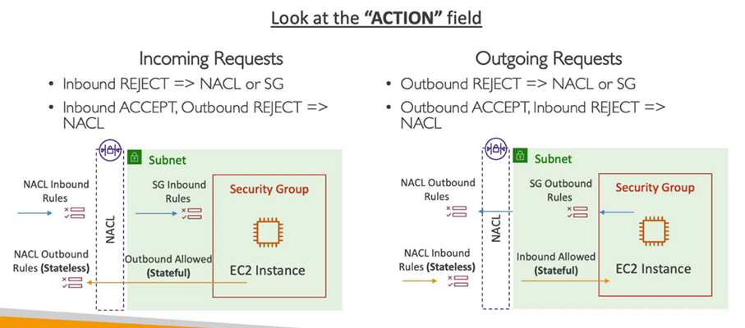
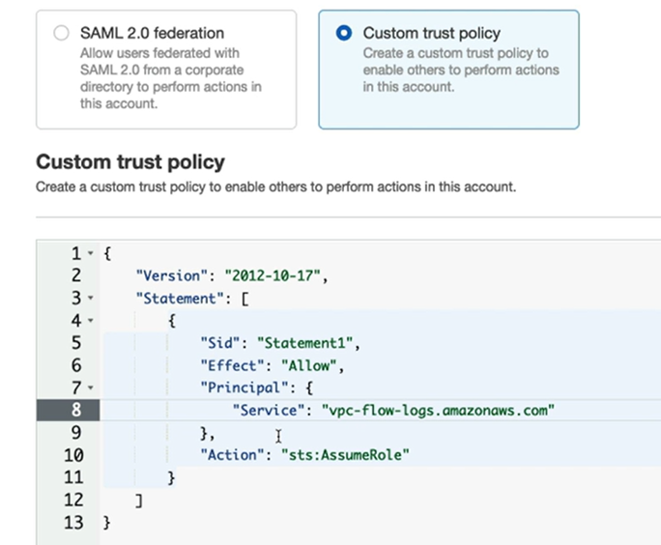
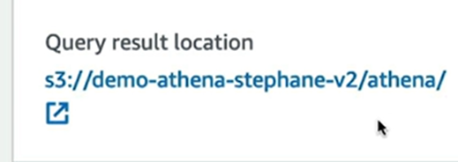

Slide 9
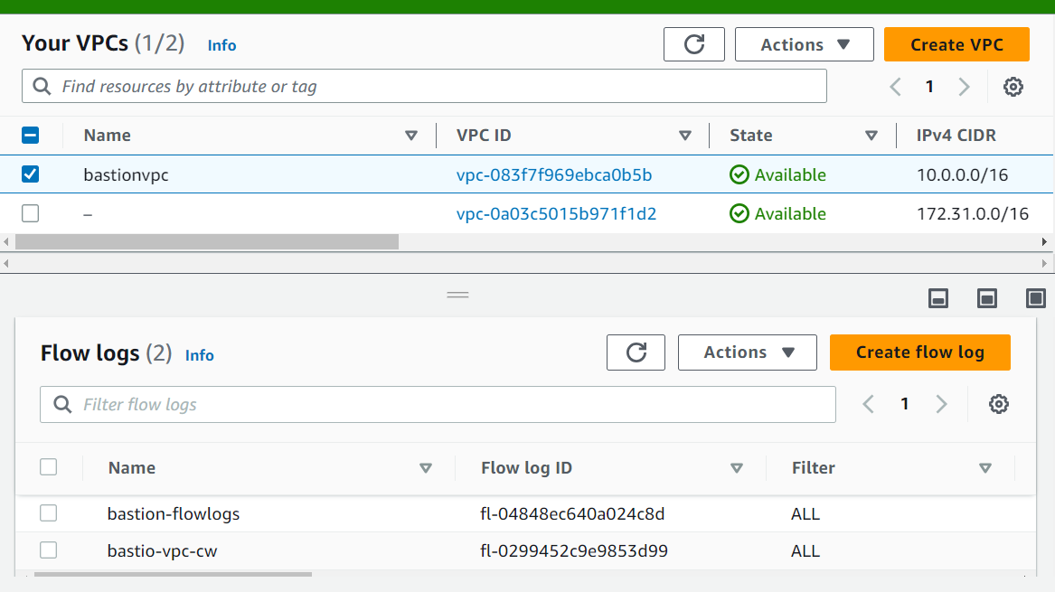
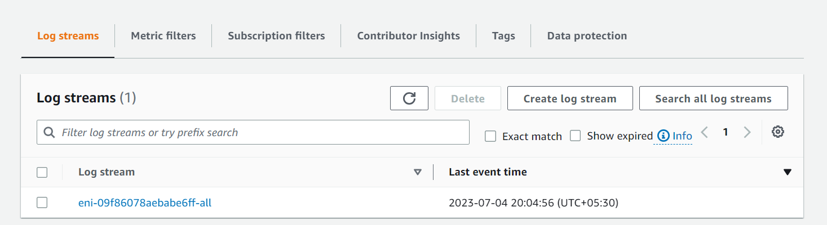
Before nat

Slide 10
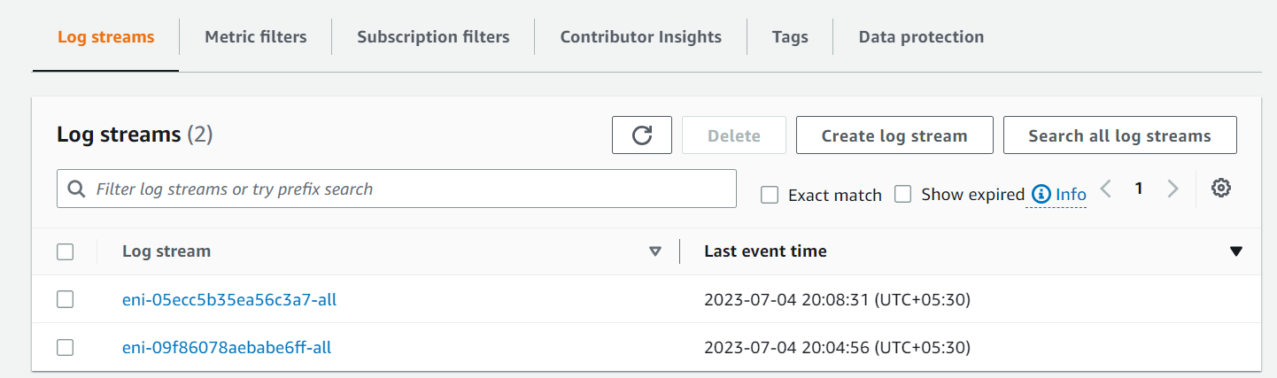
After nat- connection

Slide 11
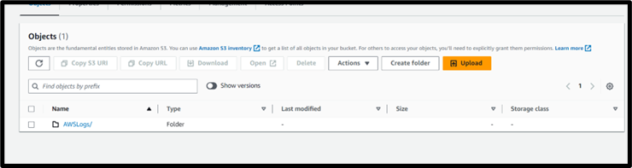

Slide 12
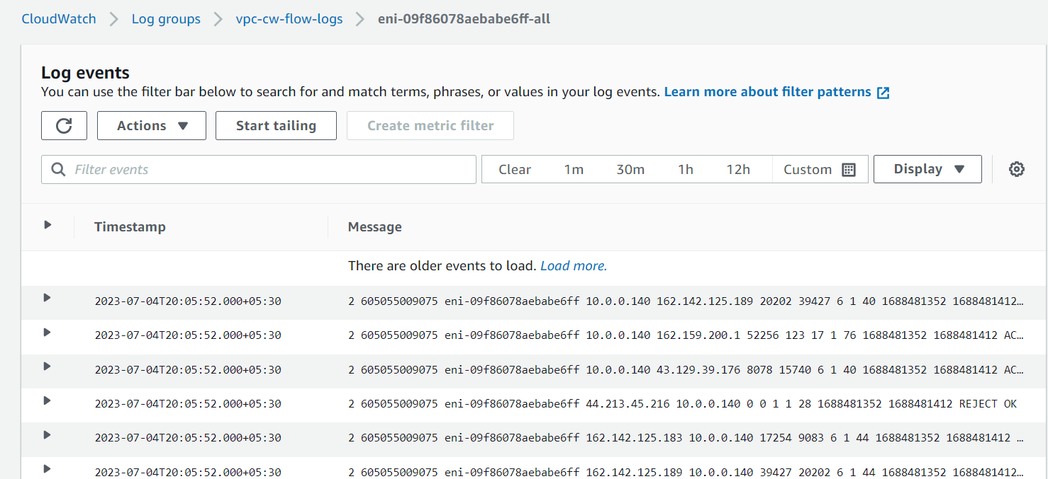
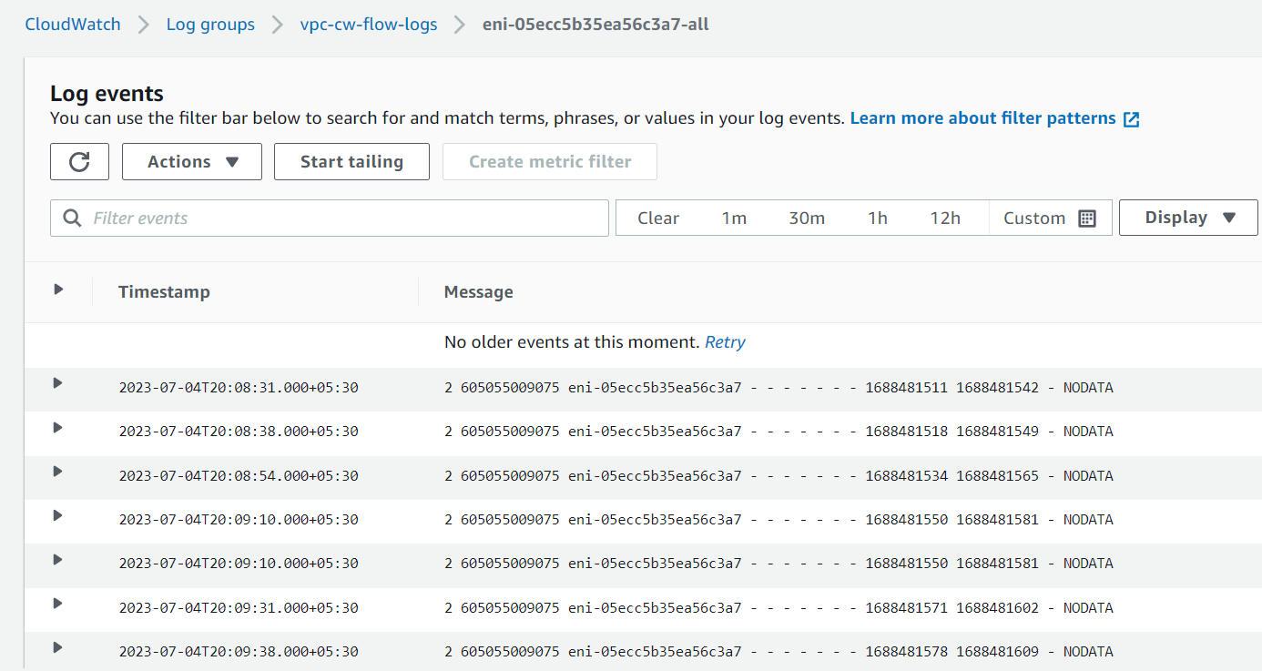
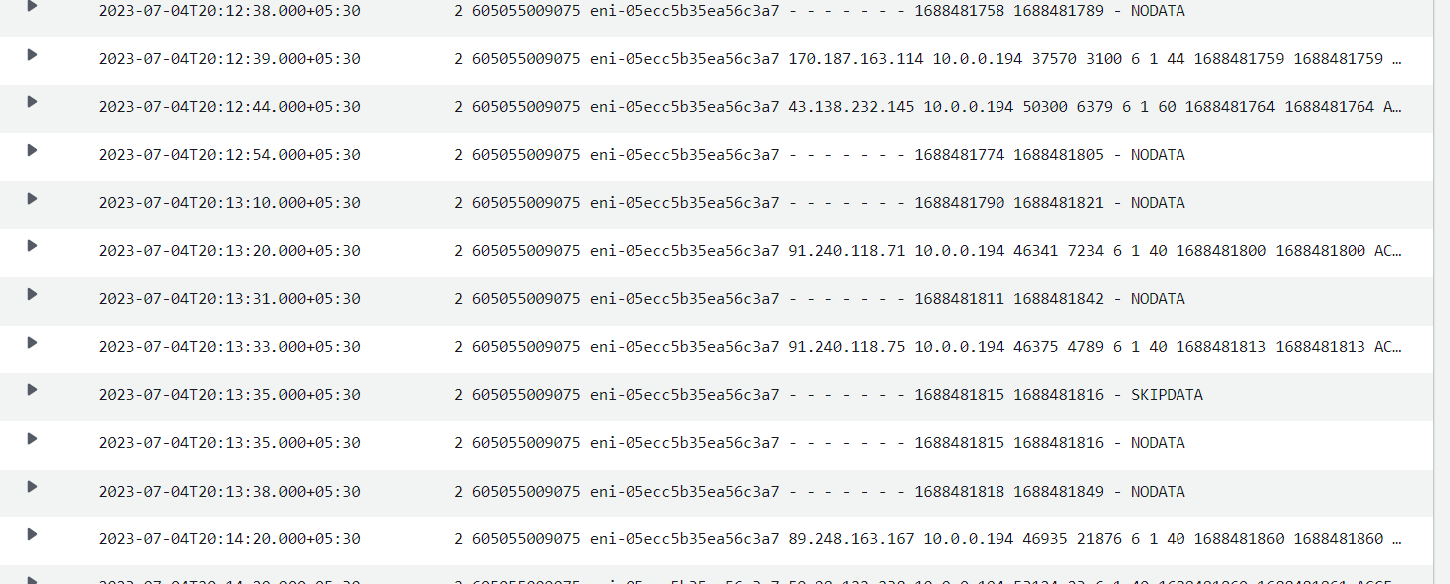
Cw flow-logs: bastion server
Cw flow-logs: Private ec2

Slide 13
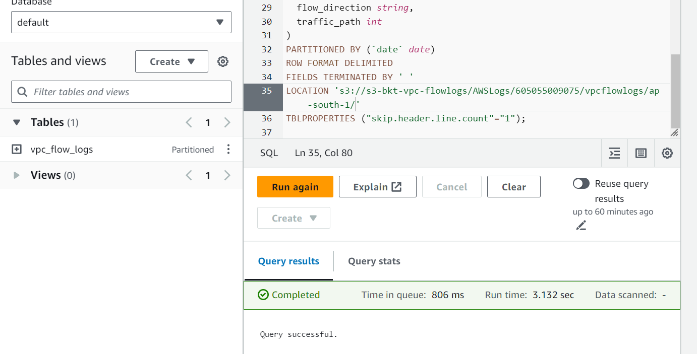
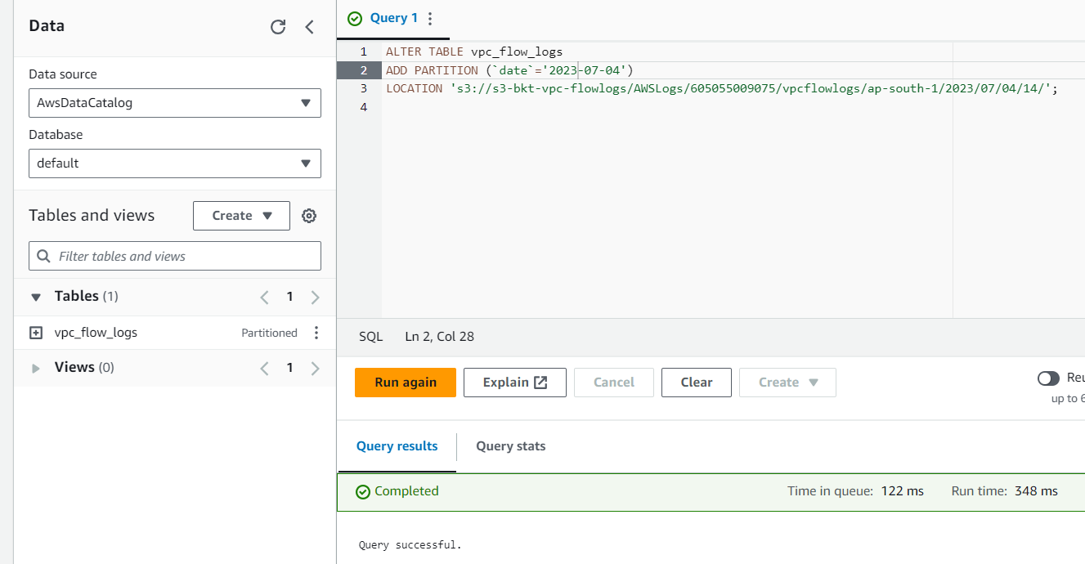
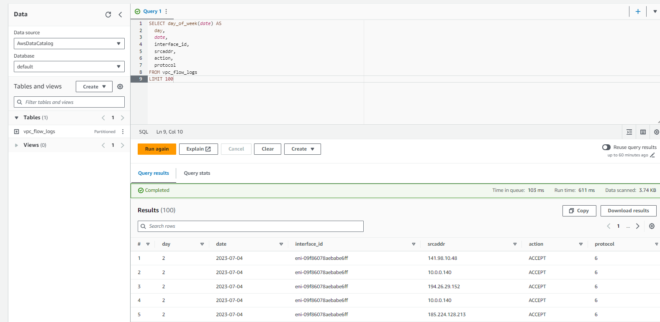
Anthena editor: flow logs table creation
Anthena editor: This query creates a single partition
SELECT day_of_week(date) AS
day,
date,
interface_id,
srcaddr,
action,
protocol
FROM vpc_flow_logs
LIMIT 100
Anthena editor: This query lists all of the all TCP connections

Slide 14
